Slide 1



MAXIM INTEGRATED
SPEECH ENHANCEMENT
Stella Cao, Renjie Liu, Huaxuan Wang, Curtis Zhuang

Slide 2







Clean speech is better
1

Slide 3


Project Roadmap
Background
Problem Statement
Knowledge Expansion
Candidate Model
Next Steps
Findings and Discussion
Data and Methodology
2

Slide 4
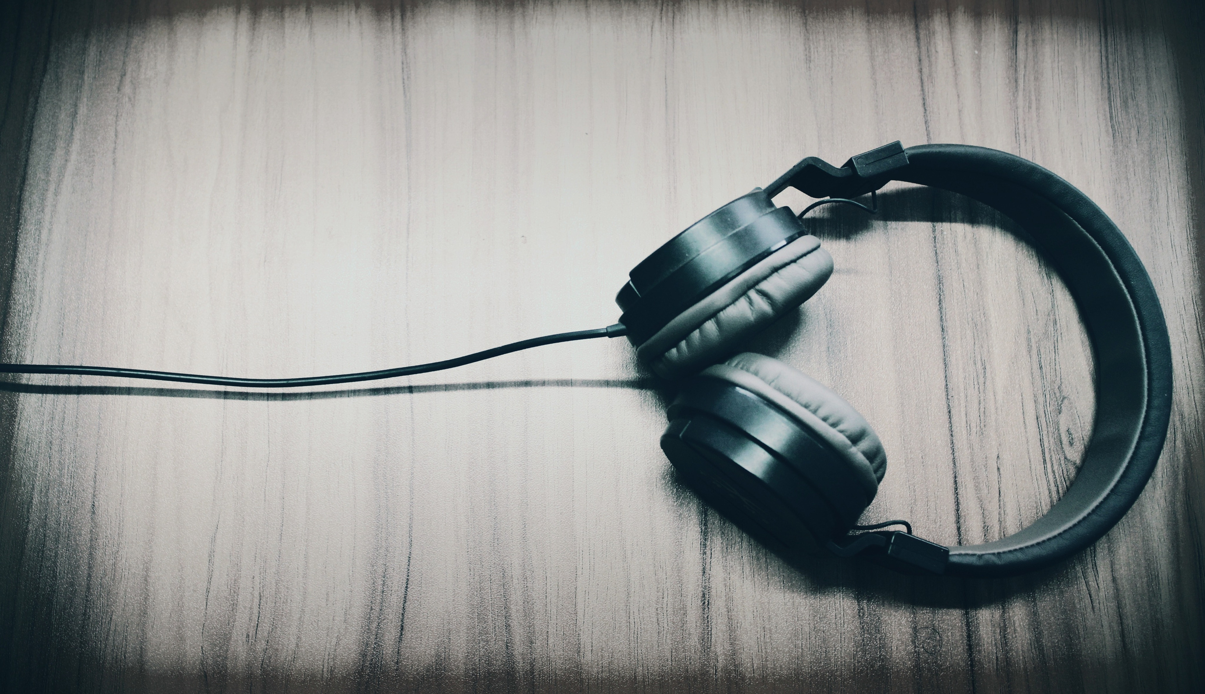

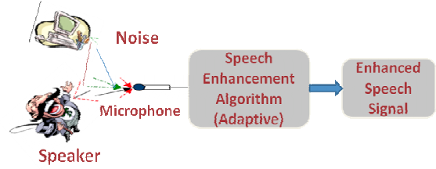
Working With An Analog Device Company
MAXIM INTEGRATED
Technology manufacture
MAX78000 accelerator
SPEECH ENHANCEMENT
Improve mixed speech
Zoom and Microsoft Teams
3

Slide 5
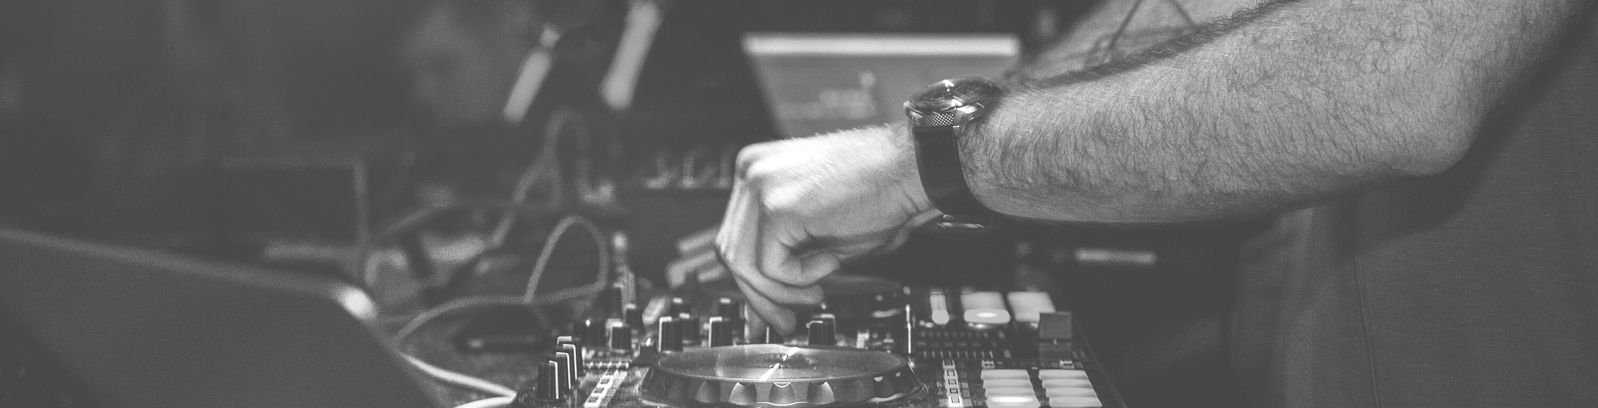
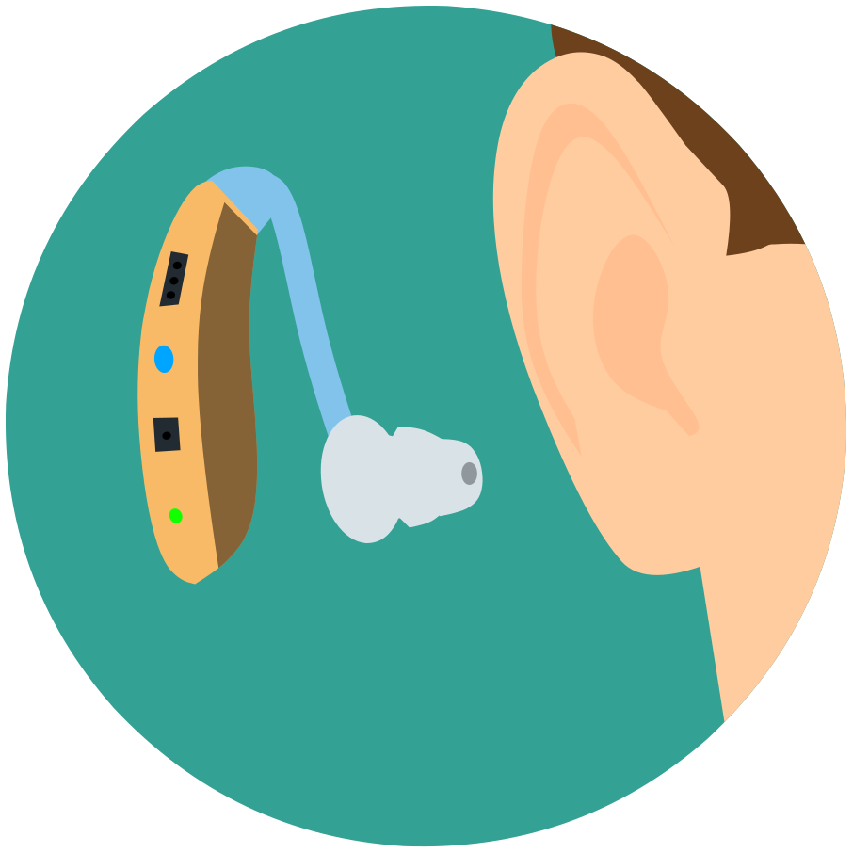
Speech Enhancement Is A Harder Problem
Noise Cancellation Headphones
Hearing Aid Requirements
Reduce ambient sounds using active noise control
Enhance speech
Aesthetic concern
Power-efficient
4

Slide 6



Huge Revenue Potential For Maxim
We developeded a speech enhancement algorithm that enables Maxim Integrated to participate in a $300 Million total addressable market.
About 28.8 million U.S. adults could benefit from using hearing aids
Max78000 priced at around $10
$300 Million
5

Slide 7
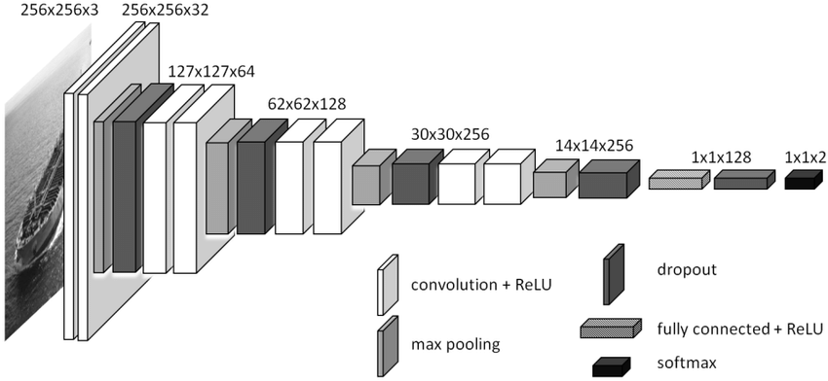

PROBLEM STATEMENT
Develope and implement machine learning methods, compatible with Maxim Integrated's MAX78000, to enhance speech for hearing aid devices with latency less than 10ms*.
6

Slide 8


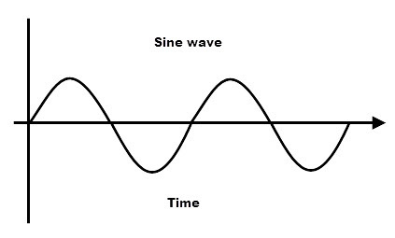
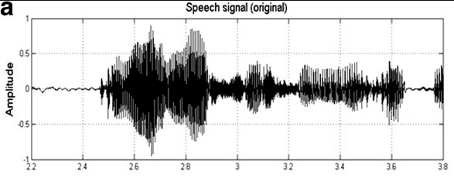

Signal
Signal Is
Basic of Speech
Signal is a variation of air pressure changed over time
Recording Signals
Single-Frequency Signal Time Domain Chart
To digitally record signals, air samples are taken over a period of time. The sampling rate commonly is 44.1k samples per second, aka 44.1k Hz
Single-Frequency Signal
In real-life, the signal consists of different single-frequency signals
7

Slide 9

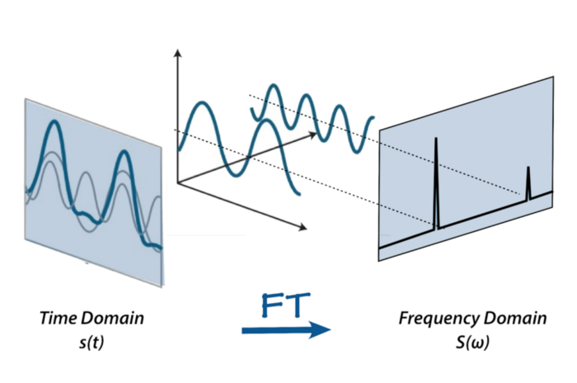

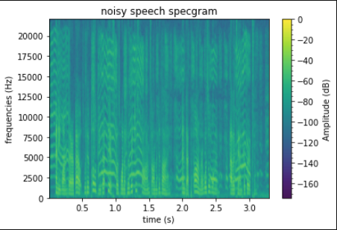


What Is Fourier Transform
Fourier Transform
Apply the Fourier transform (FT) to decompose a signal into individual frequencies and its amplitude. But our speech's frequency content varies over time
Short-Term Fourier Transform
Short-term Fourier transform (STFT) performs Fast FT on windowed segments of the signal. The result can be visualized by Spectrogram
8

Slide 10
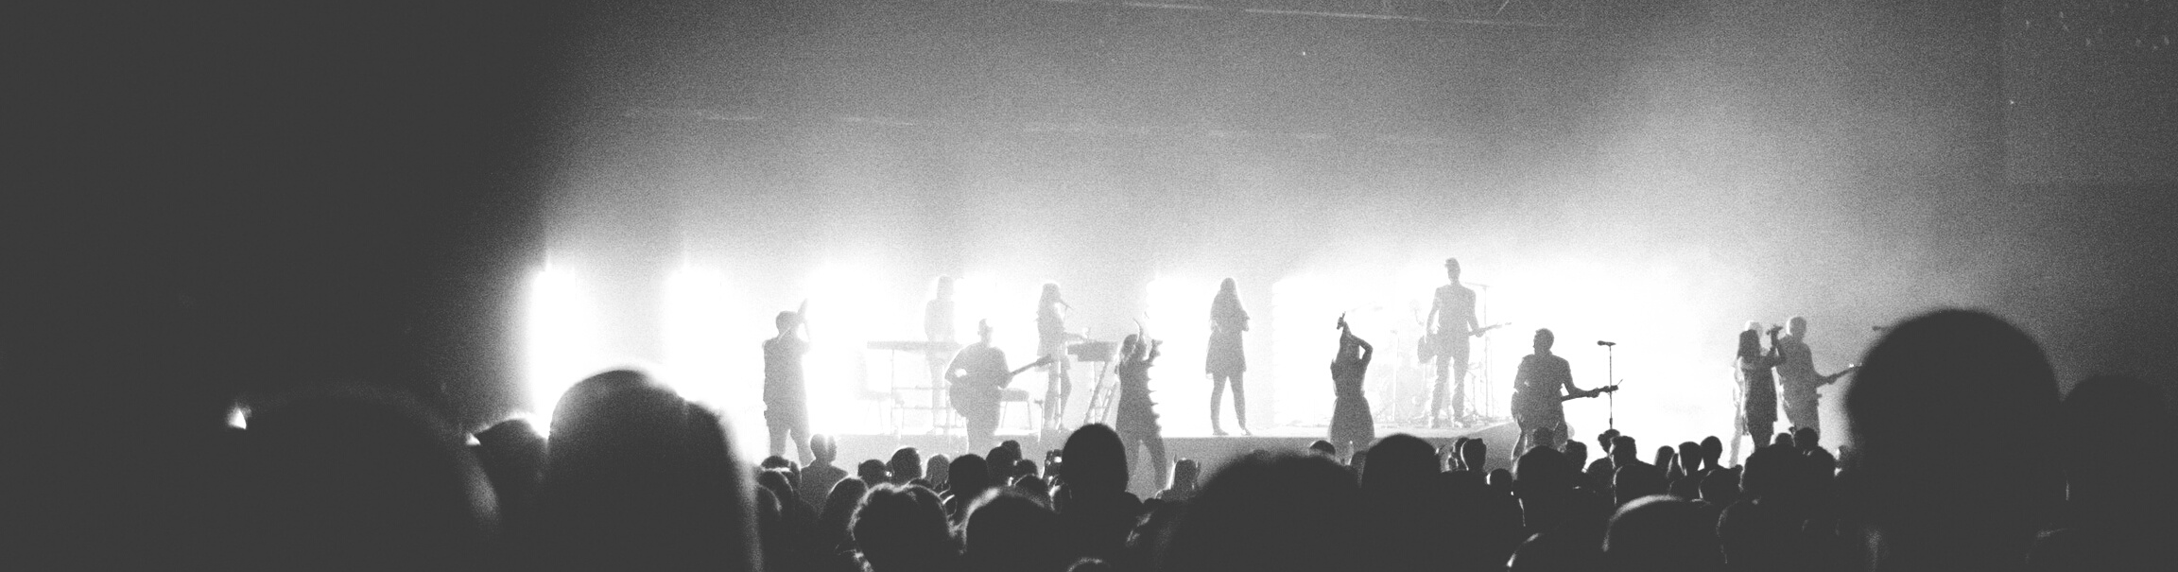


Current Strategies for Speech Enhancement
Mapping-based (End to End)
(Asri et.al 2021)
Mask-based
(Asri et.al 2021)
Map a non-linear function from the noisy speech into the enhanced clean speech
Less sensitive to SNR variations
Reconstruct the target output from the observed input
Estimate a mask to filter to the input spectrogram
Different types of mask
Ideal binary mask (IBM)
Ideal ratio mask (IRM)
9

Slide 11


Convolution Models Suit better than GRU and GAN for its efficiency
R-CED - CNN Model
(Park & Lee 2016)
U-Net
(Stroller, Ewert & Dixon 2018)
CNN models have lesser number of parameters and can be used in embedded devices
CNN models has encoder and decoder structure which is suitable for generation tasks
Can perform either mapping-based or mask-based tasks
U-Net strucutre is a symmetric convolutional network investigating end-to-end source separation
The architecture's encoder captures context and the symmetric expanding path enables precise localization with its skip-connection which retains information both from the bottlenet and the convolutioned counterpart
10

Slide 12




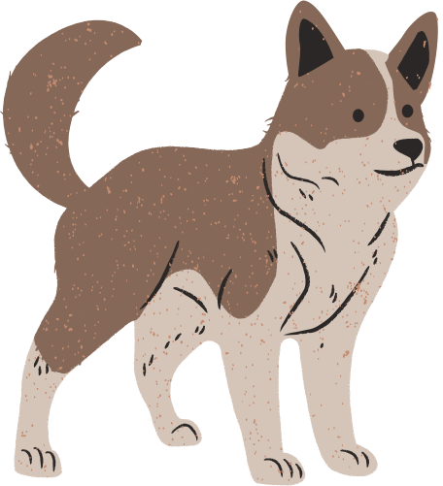

We mixed 6 noise types with clean speech
Speech
OpenSLR LibriSpeech ASR corpus data which contains corpus of read English speech divided into train (100 hours) and validation (5 hours).
Traffic Sounds
16.7%
White Noise
16.7%
Noise (from Youtube)
Stationary:
White
Quasi-Stationary:
Siren
Non-Stationary:
Traffic, Baby crying, Dog barking, Diesel truck
Engine Sounds
16.7%
Dog Barking
16.7%
Siren
16.7%
Baby Crying
16.7%
11

Slide 13

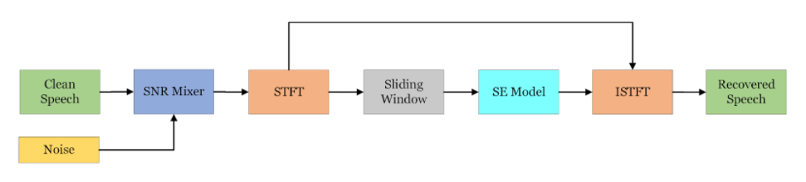

PyTorch Data Pipeline Modules
End-to-End
Speech Enhancement
1
Read clean speech and noise
Generate noisy speech
Apply STFT
Perform Sliding Window
Fit Speech Enhancement Model
Recover speech using ISTFT
2
3
4
5
6
12

Slide 14
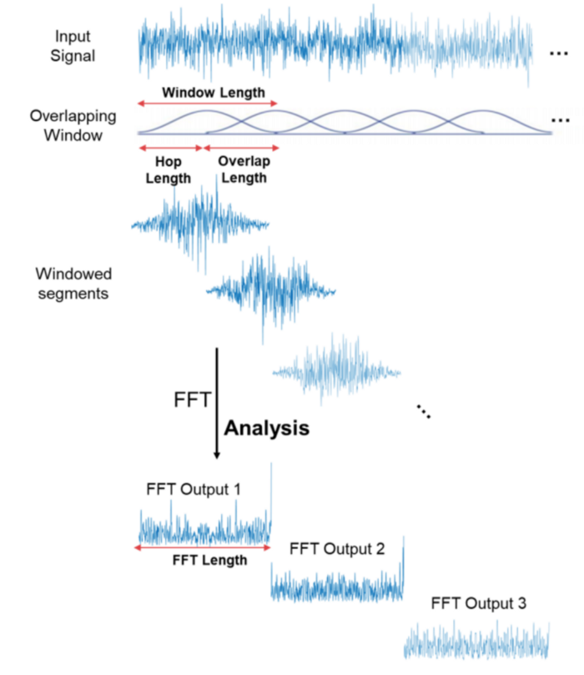
Feature Engineering
- Fourier Transform
Parameter of STFT:
Window Length: 512 (32 ms)
Number of FFT: 512
Hop Length: 128 (8 ms)
Transform speech to magnitude (real-valued) and phase (complex-valued)
13

Slide 15

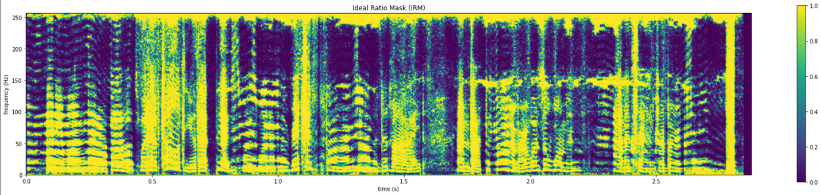
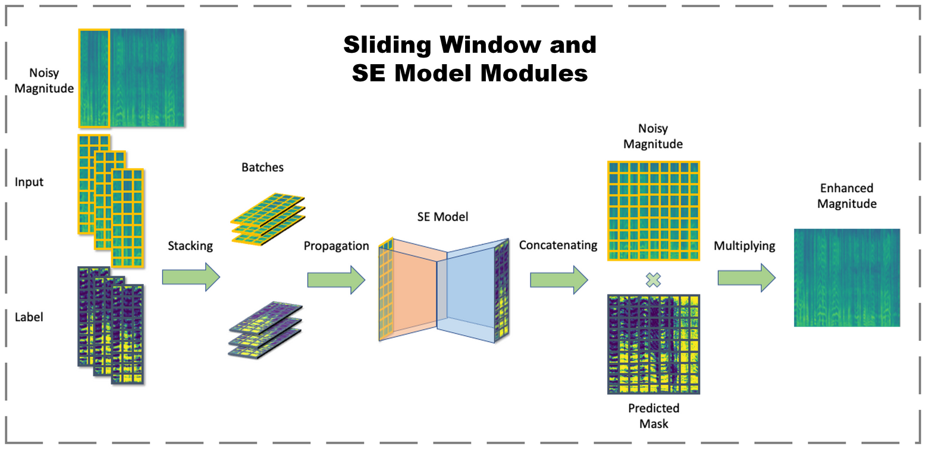
Feature Engineering
- Sliding Window & Masking
Sliding Window:
Fix time dimension
Create temporal context as model inputs
Ideal Ratio Mask (IRM):
Label of the model
Smoothed version of IBM
14

Slide 16

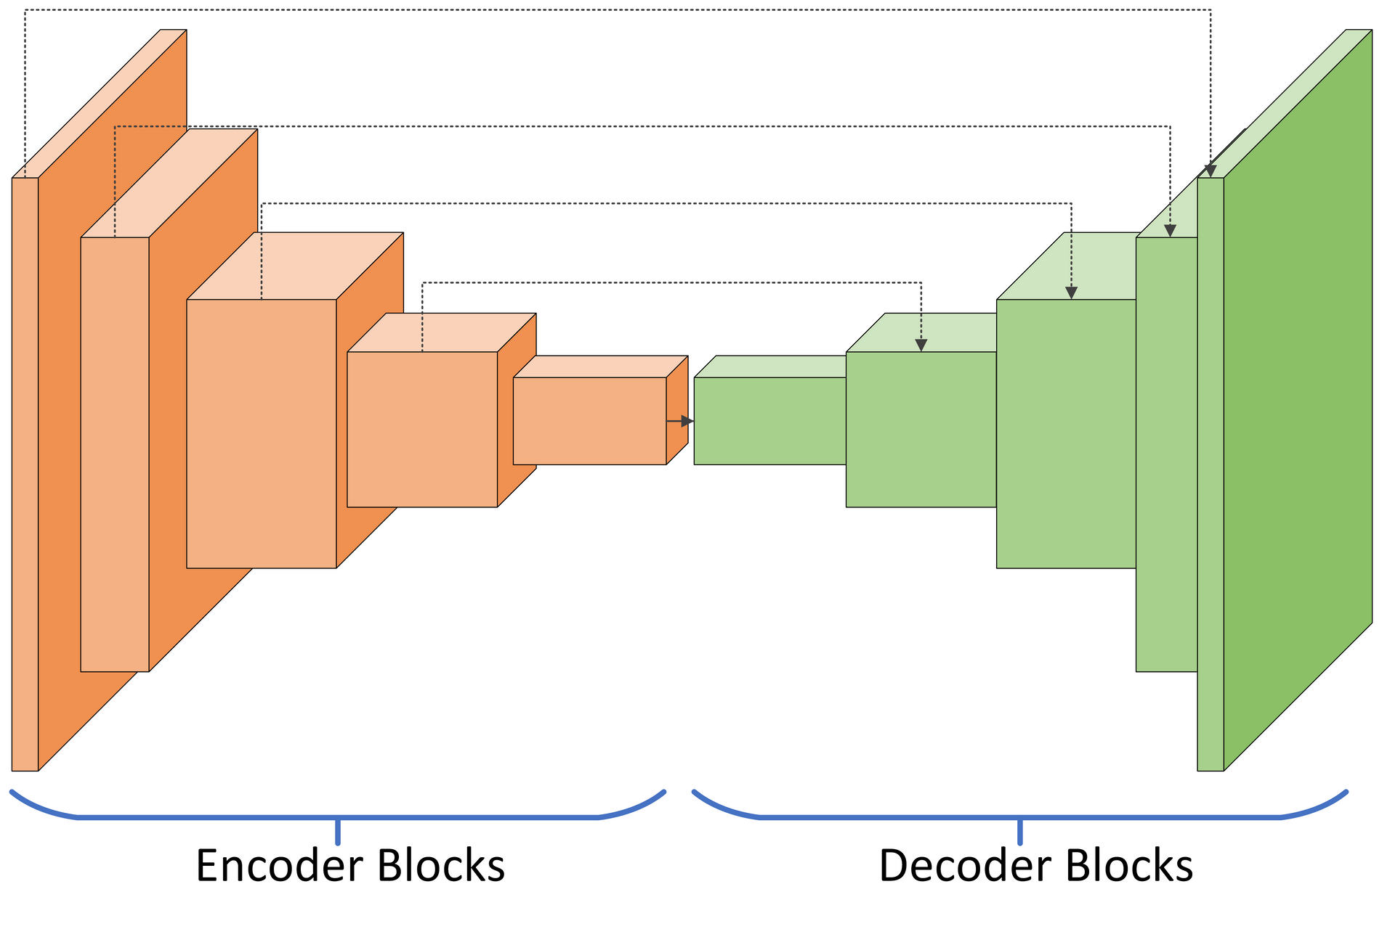

Proposed Model
What the Basic Model Looks like
Encoder-Decoder based CNN
Objective
Remove specific noise types
Lightweight
Architecture
Encoder Block:
Conv2d, BatchNorm, Max-Pooling, and ReLU
Decoder Block:
TransposedConv2d, BatchNorm, and ReLU
15

Slide 17
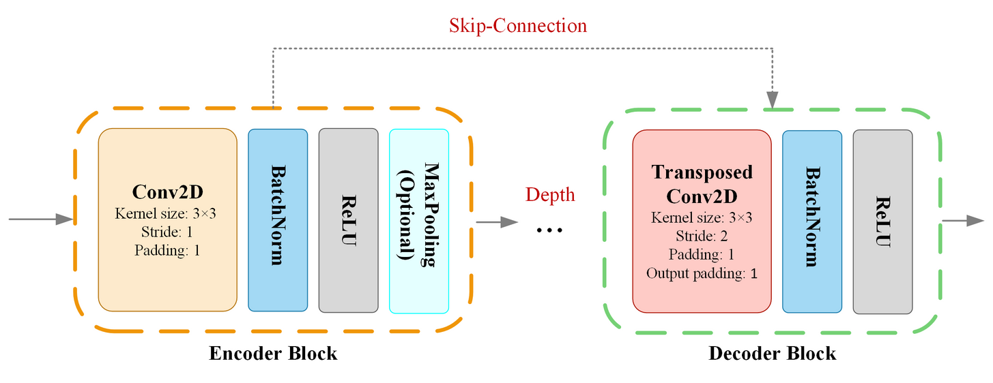
Final Model Details
Efficient UNet-128 parameters based on MAX78000 hardware
Hardware limitation
Efficient UNet-128 parameter
Kernel Size: 3x3
Conv2d:
Stride: [1, 1]
Dilation: 1
5 encoder blocks
5 decoder blocks
Max channel size: 256
Kernel size: 3x3
16

Slide 18
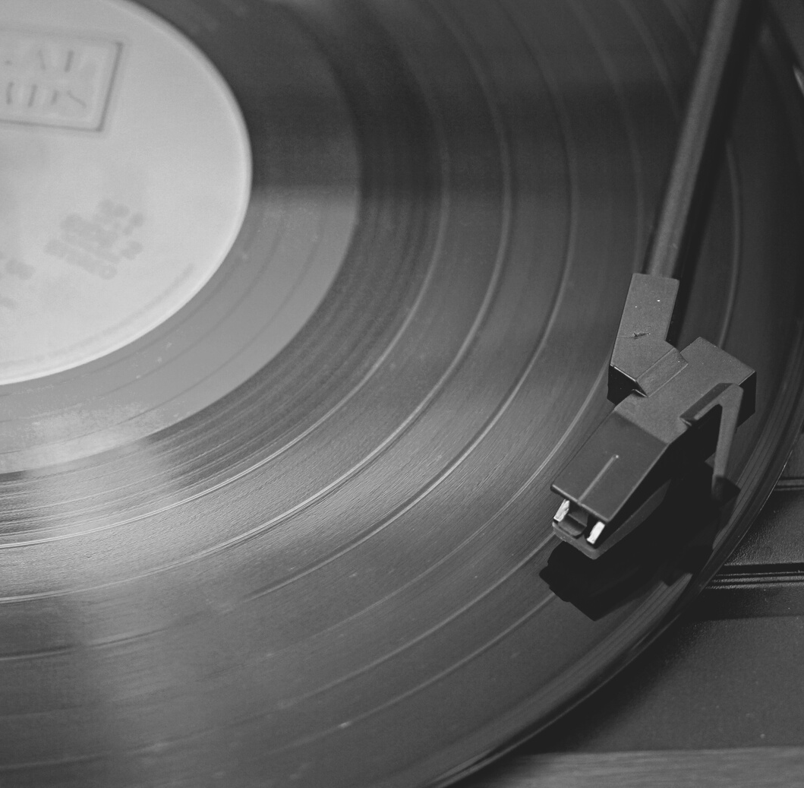


Noise Reduction
How to Evaluate Speech Properly
Segmental Signal-to-Noise Ratio (segSNR)
Signal / Noise
Higher segSNR, lower noises
Speech Quality
Perceptual Evaluation of Speech Quality (PESQ)
From -0.5 (bad) to 4.5 (good)
Speech Intelligibility
Short-Time Objective Intelligibility (STOI)
From 0% (bad) to 100% (good)
17

Slide 19
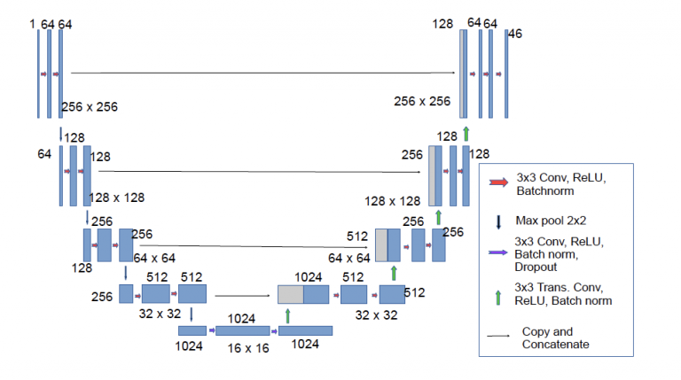
U-Net Stands Out
Hypothesis:
U - Net will be small enough to be embedded on Max78000 and achieve required speech enhancement performance.
Flexible Size
High performance architecture
18

Slide 20


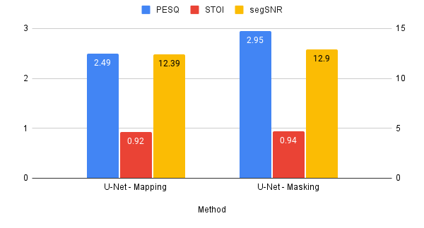
Noise Reduction (segSNR)
Train
Validation
25
U-Net
Significantly improves all 3 metrics
Benefit from flexible of encoder-decoder architecture and skip-connection
Mapping Method
Unclear speech
Masking Method
Better performance
20
15
10
5
0
Noisy
CNN Baseline
R-CED
SimpleNet
U-Net
U-Net With Masking Performs The Best
19

Slide 21
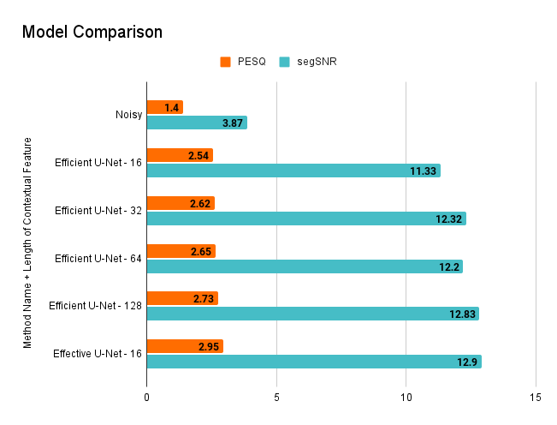
Effective UNet-16
The best performance
Too large to deploy on MAX78000
Efficient UNet
More contextual features, better performance
Efficient UNet -128
Achieve similar performance with Effective UNet-16
Small enough to embed on MAX78000
Latency less than 3.3 ms
Efficient U - Net -128 Will Be Embedded
20

Slide 22







Significant Improvement In Different Noise Types
PERFORMANCE ON DIFFERENT NOISE TYPES
White Noise
Siren
SSNR increased 8.89 dB
PESQ increased 1.01
STOI increased 6%
SSNR increased 16.46 dB
PESQ increased 1.99
STOI increased 9%
Baby Crying
Small UNet-128
Traffic Sounds
SSNR increased 10.61 dB
PESQ increased 1.80
STOI increased 14%
SSNR increased 9.41 dB
PESQ increased 0.92
STOI increased 11%
Dog Barking
Engine Sounds
SSNR increased 0.32 dB
PESQ increased 0.33
STOI increased 6%
SSNR increased 10.71 dB
PESQ increased 1.25
STOI increased 8%
21

Slide 23
Model Structure & Size Have Huge Impact on Performance
Metric Evaluation
U-Net Structure
The model captures stationary noises well, while for non-stationary noises, the performance varies, especiallly dog bark.
Metrics may not capture all human perceivable components.
U-Net structure allows the upsampling process to retrieve data from not only the bottleneck but retain speech resolution from the downsampling counterpart in encode-decoder.
Mapping vs Masking
Model Size
Masking method has better speech intelligibility and quality as it is less prone to error caused by latency which is preferred in real-time.
Larger kernels, with more channels capture more features and the use of pooling layers in small models affect the upsampling process when retaining information.
Large models have small temporal context.
22
Notes:
dog bark is explosive and intermittent, explosive difficult because not enough time to train
he encoder-decoder architecture extracts useful features in the encoder parts, while the decoder parts recover the corresponding target using extracted features from the encoder parts. Moreover, the long skip-connections guarantee features from the bottom of the U-Net can be flowed to the Transposed Convolution layer to recover patterns of the speech. T

Slide 24


Our Contribution to MAX78000
High Performance
Compatibility
Reduce unwanted ambient sounds using active noise control
Average improvement by 8 times (segSNR increased by 8.96 dB)
Latency less than 3.3 ms
Adjust model to MAX78000
Model deployment on MAX78000 is currently in progress
High marketing potential
23

Slide 25








Current model opens space for futher growth
Hardware
Model: self learning
More noise types
Latency
Mixed noises
Languages
24

Slide 26
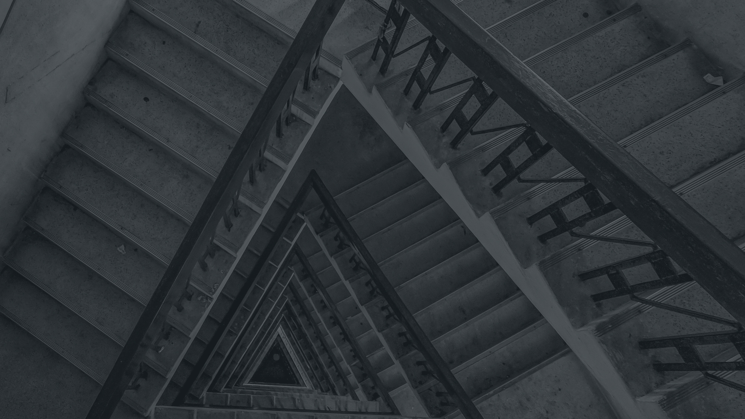
Next Steps on Speech Enhancement for MAX78000
Domain Adverserial Training
Optimize with MAX78000
Add more noise types and mix inputs
Add more languages
25

Slide 27
Flask Demo
26

Slide 28
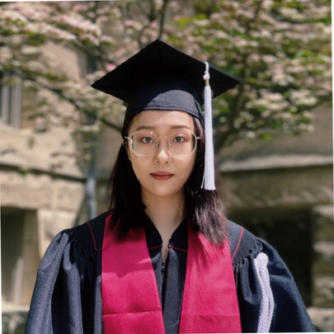



Questions, comments, or suggestions?
Reach out to us!
STELLA CAO
RENJIE LIU
CURTIS ZHUANG
HUAXUAN WANG
zijcao@uchicago.com
renjiel@uchicago.edu
shengyan@uchicago.edu
huaxuan@uchicago.edu
27

Slide 29

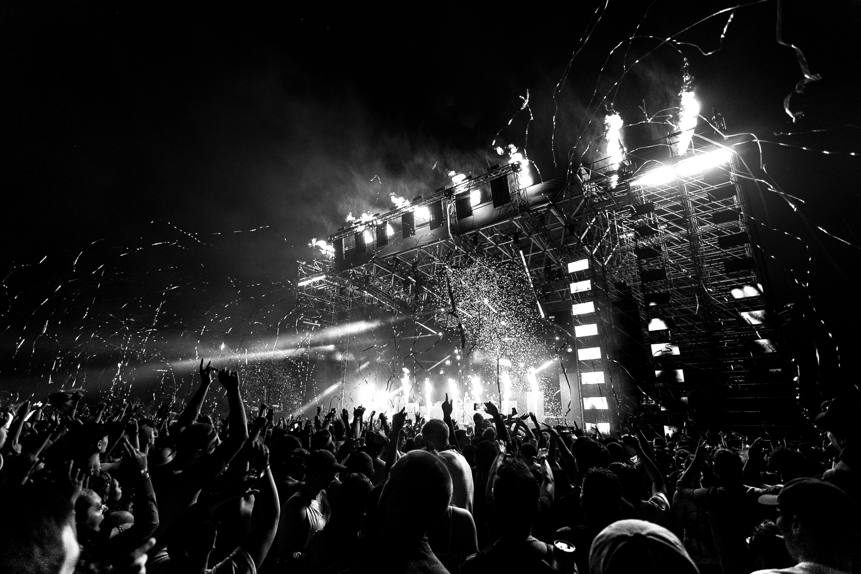
THANKS FOR WATCHING
Special thanks to Dr. Batuhan Gundogdu, Dr. Utku Pamuksuz,
Chris Olen and Scott Shepard for their advice and assistance in our project
28

Slide 30

Appendix
Generate Noisy Speech(P30)
ISTFT Model(P31)
Ideal Ratio Mask(P32)
Why Don't Use Phase(P33)
Hearing Aid Future Market(P34)
Masking and Mapping (P35)
Q & A
29

Slide 31
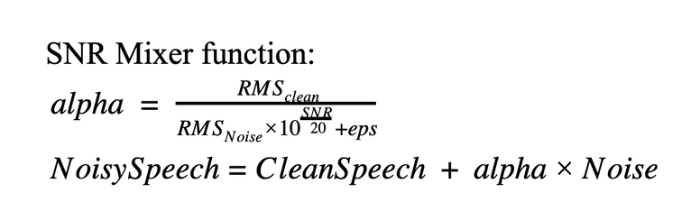
Generate Noisy Speech
A custom PyTorch dataset module
Total 30 conditions are considered:
6 noise types
5 different SNR each (-10 dB, -5 dB, 0 dB, 5 dB, 10 dB
SNR Mixer function generate noisy speech given specific SNR value
30

Slide 32
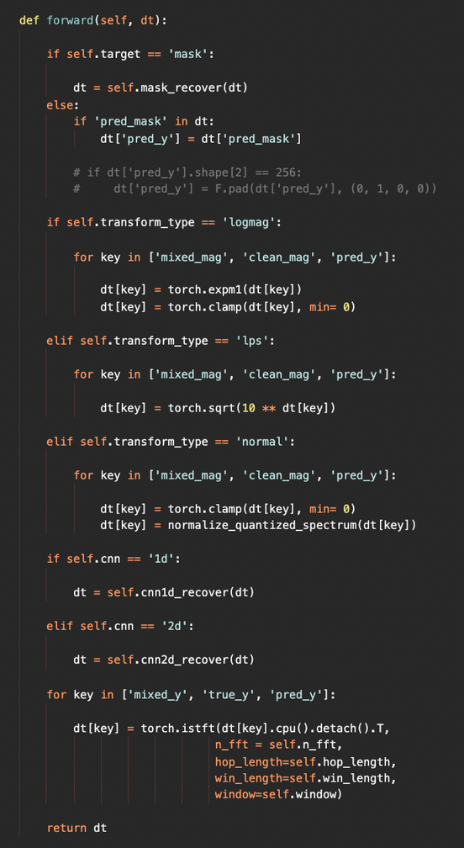
ISTFT Module - Recover Back to Speech Audio
A custom module that wraps up PyTorch's istft function
The predicted mask are multiplied with noisy magnitudes to get enhanced magnitude
Applied transformation back (log transform, log powered transform, and quantization) on magnitude
The istft function that has same parameter setups with stft function takes both magnitude and phase to generate enhanced speech audio
31

Slide 33
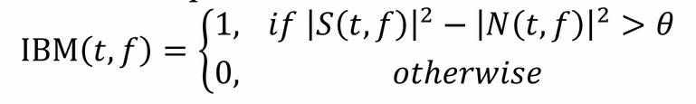
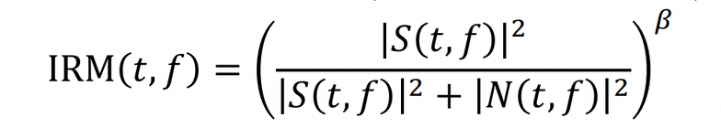
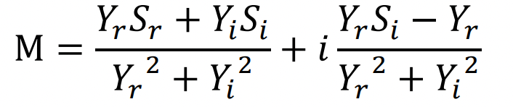
Ideal Ratio Mask
Ideal Binary Mask (IBM)
Make the speech enhancement to binary classification task
Ideal Ratio Mask (IRM)
smoothed version of IBM
Predicting the ratio between clean speech and noisy speech
Widely used in SE community
Other Masking strategies
Take account of phase
Complex Ideal ratio mask (cIRM)
Phase sensitive mask (PSM)
32

Slide 34
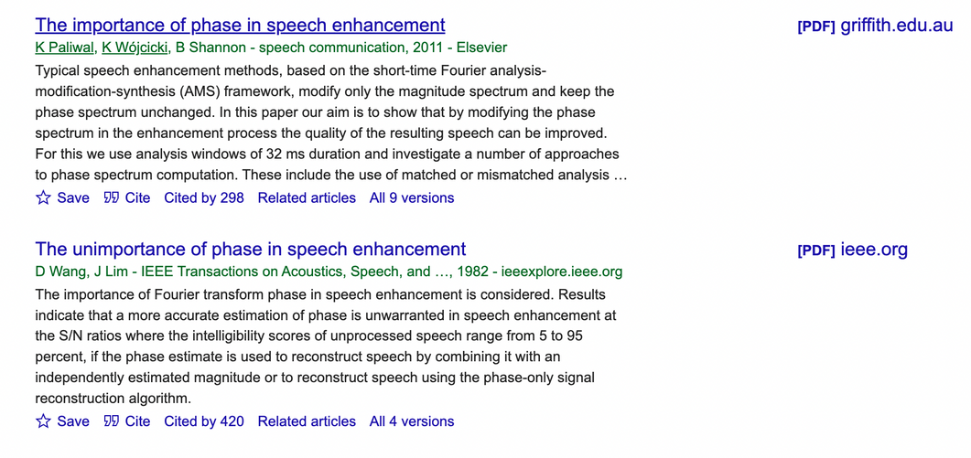
Why Don't Use Phase
Phase may or may not contain useful information for Speech Enhancement task
The unimportance of phase in speech enhancement (Wang, D., & Lim, J. , 1982)
The importance of phase in speech enhancement (Paliwal, K., Wójcicki, K., & Shannon, B. , 2011)
Involved complex-valued computation
Not suitable for MAX78000 device
33

Slide 35
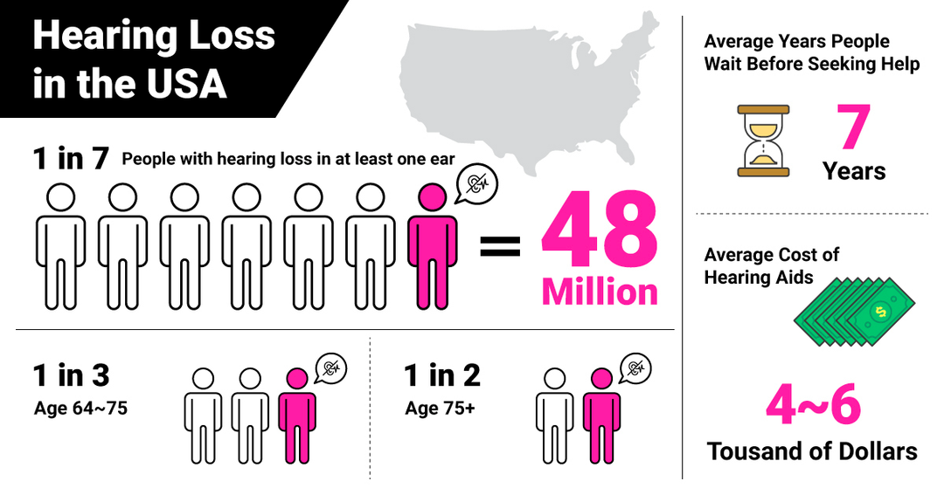
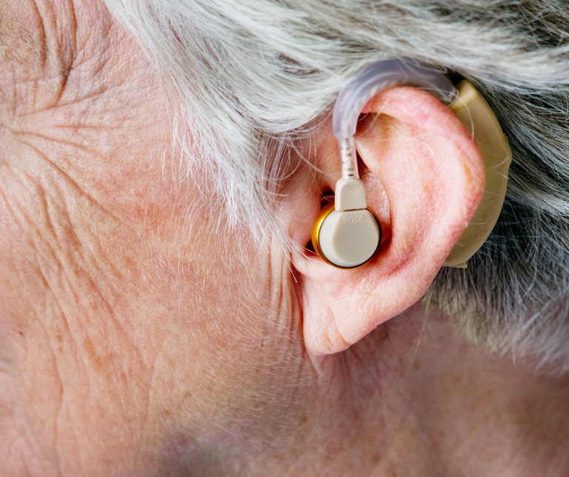
Hearing Aid Future Market
The global “hearing aids market” size is expected to reach $11 billion by 2028, exhibiting a CAGR of 7.4 % during the forecast period.
34

Slide 36
Masking vs Mapping
CNN and CDAE are less affected by training target and show masking and mapping approaches are approximately giving the same performance.
'The performance of masking targets was shown to be much better at high SNR for all architectures, leading to a higher variance for all the evaluation metrics than that of the mapping targets, which makes mapping targets less affected by SNR changes.' (Nossier, 2020)
35

